Slide 1


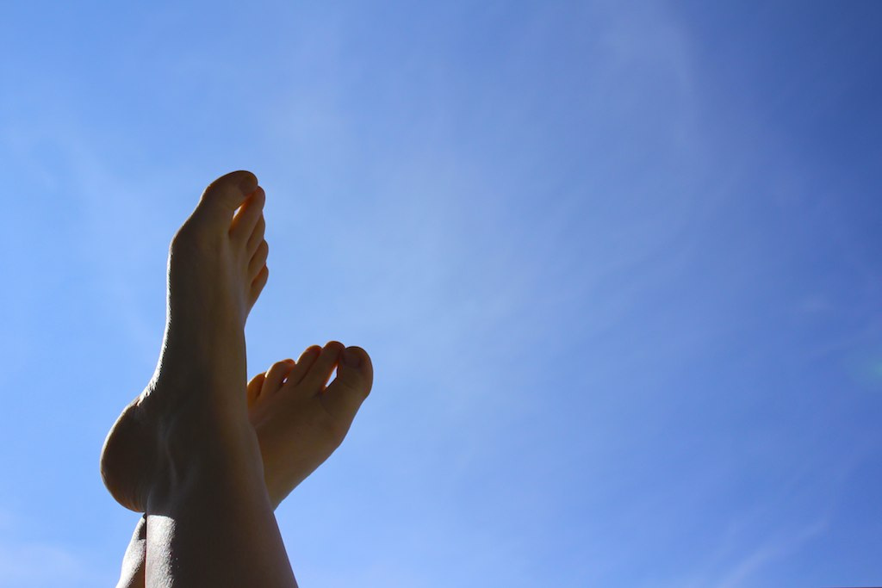
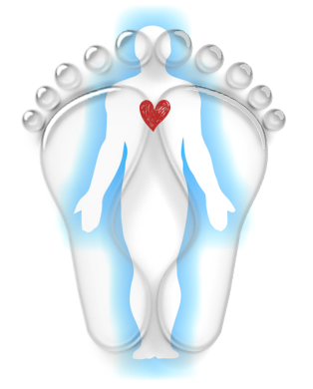


V A L E
Kim Davis BSc (Hons)
LEVEL 5 DIPLOMA REFLEXOLOGY PRACTIONER
07885 479048
REFLEXOLOGY
Daviskingsland@outlook.com
VALID FOR A FIRST DUOPODY REFLEXOLOGY CONSULTATION
(90 mins)
This voucher has no alternative cash value – Valid until 30th January 2025
VALUE £65

Slide 2
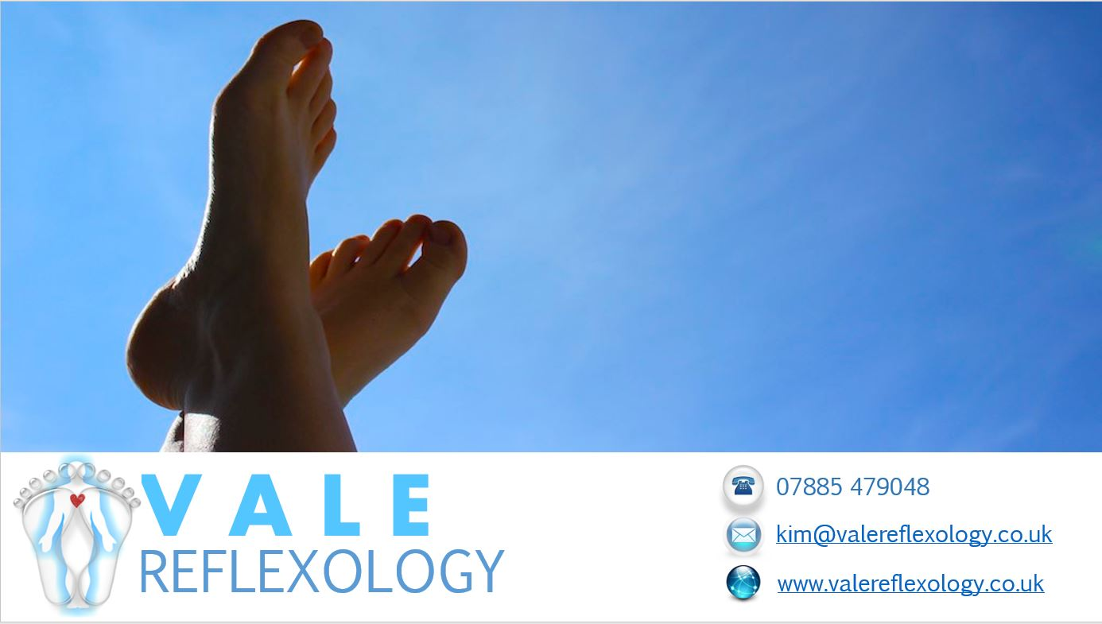
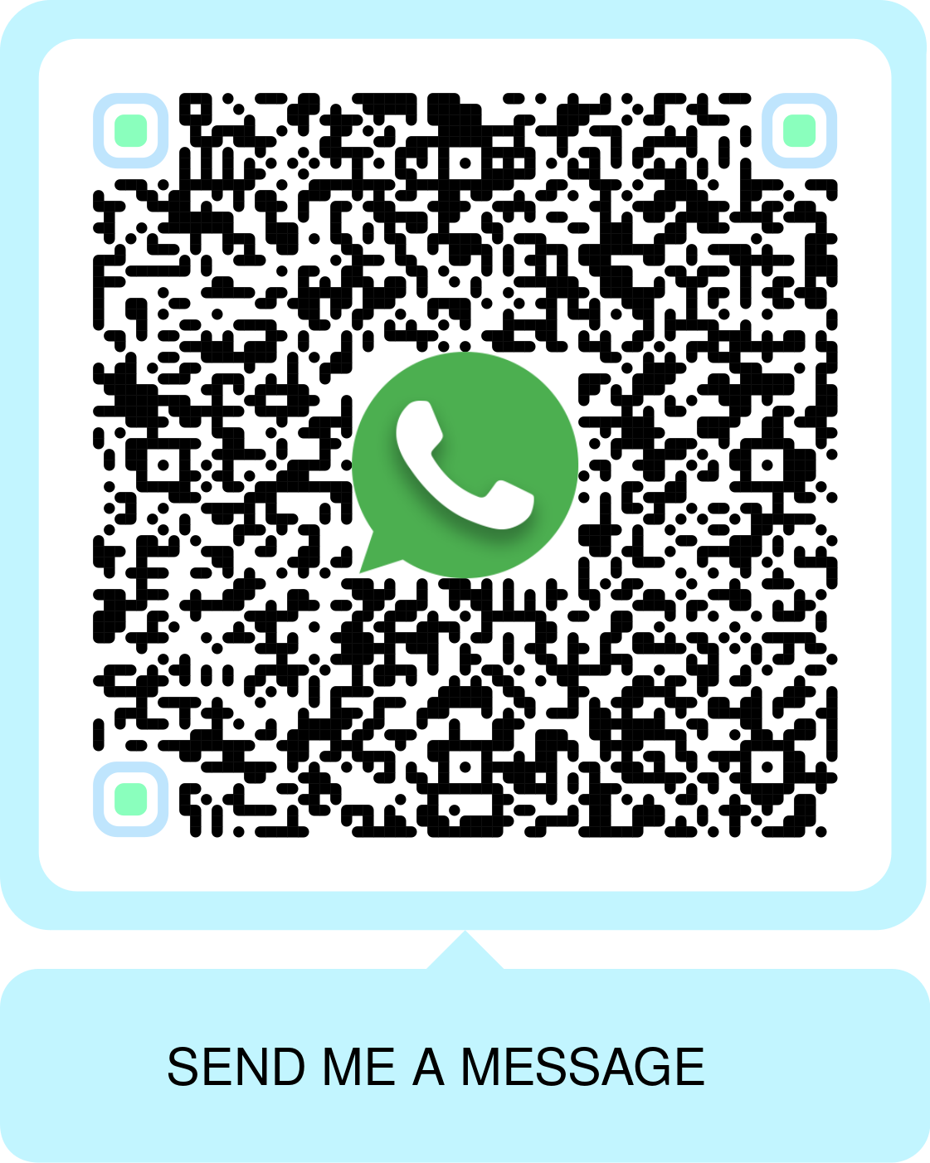
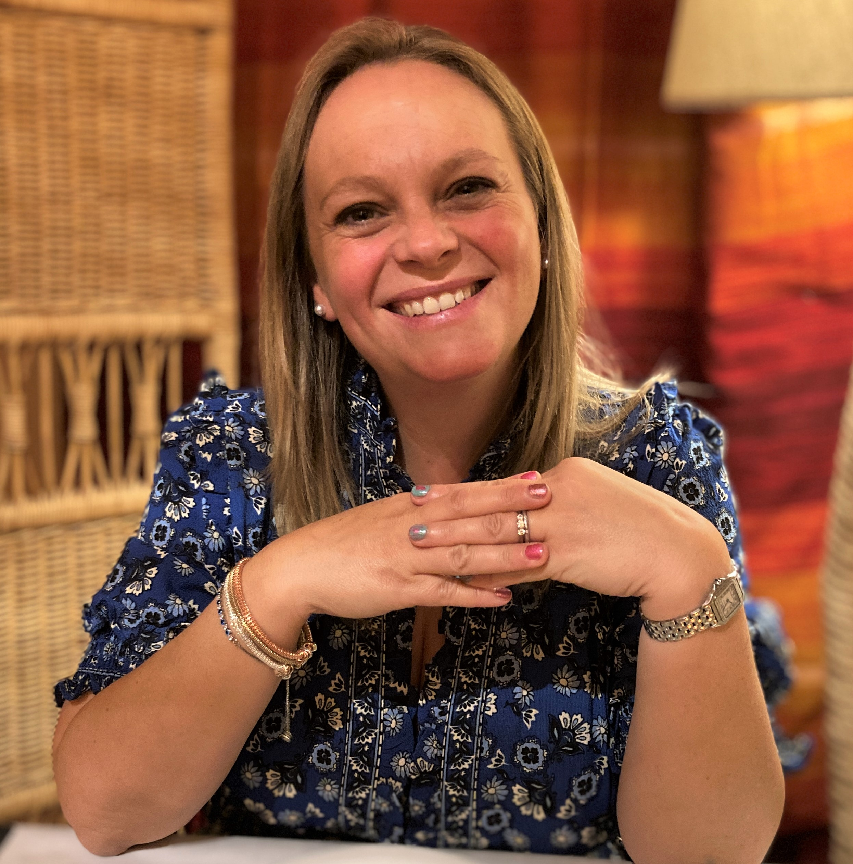
Do you suffer from stress, sleep, heart burn, depression, digestion or similar health issues?
Have you through of trying reflexology? – a holistic therapy that’s been practiced for over 5000 years to support people with these types of health problems by promoting relaxation therapy to restore the mind and body’s natural balance
My name is Kim, and I treat & improve how patients feel with Reflexology in the Vale of Glamorgan.
Level 5 Duopody Reflexology diploma qualified
Degree qualified in human biology
20 years working with medicines
I offer holistic reflexology therapy and support for both Adults and Children in and around Cardiff, Bridgend, and the Vale
© Kim Davis. Jan 2016

